Slide 1
Successful Posts
Overview of Reports and Awards and the Why

Slide 2
Primary Resources for a Successful Post
The American Legion Officer’s Guide and Manual of Ceremonies
Post Adjutant’s Administrative & Award Manual
Department Post Adjutant’s Manual
Post Finance Manual
Notes:
Link to Officer’s Guide: https://www.legion.org/publications/246556/2021-officers-guide
Link to Post Adjutants Admin: https://www.legion.org/publications/246560/2021-post-adjutants-manual
Link to Department Post Adjutant’s Manual: https://www.legion.org/publications/160964/post-adjutants-manual
Post Finance Manual: Found in the Post Operations Manual and Post Building Guide (very hard to find a copy). Also use the National Level Post Adjutant’s Manual and the Officer’s Guide and manual of Ceremonies (see above for links)

Slide 3
Objectives
Help Commanders to know what will make their Posts more successful.
Assist in providing essential information for Post Adjutants
Assist Posts in their financial operations.

Slide 4
Things to Focus on at the Post Level
Constitution/By-Laws
Membership
Reports
Financials
Record Keeping
Awards
Legion Programs
Notes:
Constitution and Bylaws: Your basic guide to: 1) what your Post is about and 2) what your own rules are. Model them on the National and Department Constitution and Bylaws and then make them specific to your Post through your By-Laws. Examples can be found at these links: https://www.legion.org/publications/247099/national-constitution-and-laws and https://www.sdlegion.org/constitution-bylaws/
Membership: No members, no Post. This is where your Officers, volunteers, talents, passions, etc., are going to come from. Recruit members from every area of a community. That’s who you’re here to serve… (Veterans and Youth).
Reports: You and your members have determined which of the 4 Pillars/Programs you’re able to bring to your community. Now that you’ve done that, take credit for your efforts. Having a good Adjutant is absolutely vital for this. You need someone who will help the membership track all the different things you’re doing; quantify them and then report them to State and National. This is also how your post competes for recognition and awards.
Financials: If you fail to take the steps to remain financially viable then your history as an American Legion Post will be short.
Record Keeping: If your post keeps good records, it makes every other aspect easier. 1) Keeping your members informed. 2) Filing reports to take credit for the things you’ve done. 3) Filing your 990 (EZ or N) Tax report, etc.
Awards: The most important part of awards is making sure the members of your post are recognized for their efforts. If you take care of your members and recognize them for the work they put in, it will ultimately lead to recognition in the form of awards for your Post from Department and National levels.
Legion Programs: This is what we are here for. The 4 Pillars of The American Legion and the individual programs that fall under each.

Slide 5
Membership
Create a membership plan (Membership Committee)
Recruiting (every member’s job)
Target Dates, Cutoff Dates, and Renewal Dates are established by National
Retention – how to do it?
Buddy Check – good video at: https://www.legion.org/training/training-tuesdays
Notes:
Membership Plan: 1) determine the “make up” of your community. 2) What portion of your community are eligible to become Legionnaires/SAL? 3) When you recruit members are you also recruiting their spouses for your Auxiliary?
Use MyLegion.org to search for veterans in your area. Have your adjutant or membership officer do a search at this link: https://mylegion.org/PersonifyEbusiness, then choose a Group; then Reports/Labels; then under Membership, click on Find Members in my Area.
Recruiting: Now you have a plan and your pool of prospective new members. Every current member is a recruiter, send them out to engage your prospective members. If you don’t ask, you will never know if they have an interest or not. Let prospective new members know what your post does for their community. Use the tools available (brochures etc.)
Target Dates – used only to determine eligibility in qualifying for Membership Awards
Cutoff Dates – dates the membership data is extracted from the National membership database for the sole purpose of printing the next renewal notices
Renewal Dates – renewal notices are sent out by National HQ if membership has not been processed by Cutoff Dates
Retention: Engage your members. Get them involved in the efforts of your post. If they like what is happening there, they will remain members. Inform members through meeting minutes and quarterly newsletters.
Buddy Check is a good way of “keeping in touch” with your members. Great ideas for doing this are talked about in a class on Buddy Checks that can be found at the web address above.
Completing Buddy Checks is important because it lets your members know that they are more than just a number and that someone cares about them. If they believe you care about them then they are more likely to help you recruit new members.

Slide 6
Membership Target Dates
Early Bird/NEF Kickoff - -50%
Fall District Meetings – 55%
Veteran’s Day – 65%
Mid-Winter – 80%
President’s Day – 85%
Legion Birthday – 90%
Children & Youth – 95%
Armed Forces Day – 100%
Notes:
These dates and targets are in the Department Post Adjutant’s Administrative and Award Manual. They are merely a guide to help you focus on where you should be during the membership year.

Slide 7
Membership Awards
Target Date – Veteran’s Day
Post level Award
Department level Award
National level Award
Notes:
Membership Awards: By Veterans Day each year, you should have a vast majority of your current members in the “renewed column”. This allows you to really focus on recruiting new members.
Make sure you are recognizing those recruiters who are going above and beyond by putting them in for awards at the Post, Department and National Levels.
Post: establish an award in the form of a steak dinner when someone recruits three new members
Department: Recognize them through the “Go-getter” program at both Midwinter and State Conventions.
National: Put them in for the National Commander Membership Excellence cap pins

Slide 8
Department Mid-Winter
Special Recognition for early Go-Getters
First Time Go-Getters
Post Award
Honor Ribbon Award
Meritorious Service Certificates
Notes:
Once you get to this point in the membership year, you should have already been recognizing your best recruiters locally, now it’s time to get them involved at the state level.
“Go-Getters are recognized at the Midwinter convention through a special banquet in their honor.
First time Go-Getters are recognized at their Spring District Meetings, so make sure they know about it and plan to attend. This of course requires the Post Adjutant to submit them as such.

Slide 9
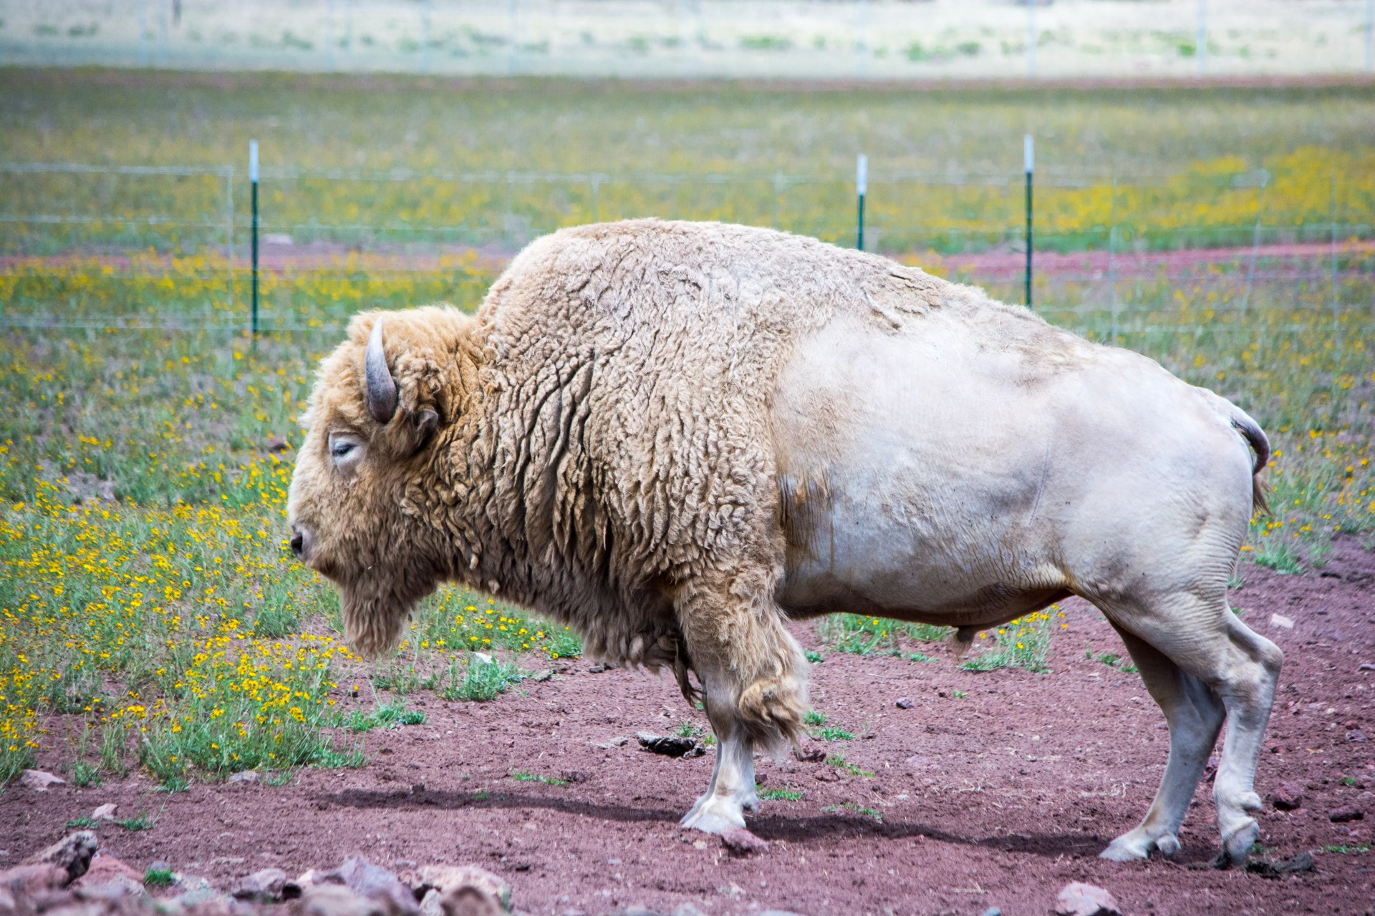
Final Award
“Pride of the Prairie Post Excellence Award”
Notes:
This is the ultimate year end Membership award. If you’ve been recognizing and rewarding your recruiters throughout the year, their success becomes the Post’s success. There’s more involved in receiving this trophy than just membership though. It is also a test of who has done the best overall job of keeping track of everything their post does and reporting it. Your Adjutant must be the king of paperwork.
Specially designed plaque will be presented at the Department Convention to the Post in each of the six goal size groups which have the highest percent average of membership over the past 2 years and meet the administrative requirements in the Department Adjutant’s Manual (pg 13)
1. Submitted the Post Data Report
2. Submitted the Consolidated Post Report
3. Certified their officers for the next year
4. Submitted the Post Americanism Report
5. Submitted a Legionnaire of the Year package to their District Commander

Slide 10
Reports
Post Data Report
Consolidated Post Report
Officer Certification Report
Post Americanism Report
Notes:
The Post Data Report is mailed to all Posts in the February time frame. It will come to the Post in the Up to Now. The form is to be filled out and mailed to Department Headquarters as soon as possible. This form confirms the Post address as well as Dues amounts and is very important to return even if nothing has changed.
Consolidated Post Report is used to collect data of what the Post has accomplished for the year. This form is mailed to each post in the Up To Now or is available on the Department web site at sdlegion.org under forms. These forms are mailed to National Headquarters by the Department so nationwide data is available and this data is used by the National Commander when he reports to congress on the activity of The American Legion. Your adjutant can also complete this at MyLegion.org site and submit directly to National.
Officer Certification Report is sent in to Headquarters immediately after elections take place to certify the military service records of the Post officers. This is important so that your officers are on the Headquarters mailing list. Also it is necessary to get Post membership cards. DO NOT MARK “SAME AS LAST YEAR”
Americanism Report due May 1st each year. This report tells the story of your participation in the Americanism programs. Each Post can compete in their size group to win the traveling Eagle Head.

Slide 11
Americanism Report
Deadline for Submission to Department - May 1
Form is found online at the Department Website:
Go to sdlegion.org → Forms → Post Adjutant Manual Forms for the form and more information on how to complete
There’s also an example of how to present your results when competing for the Americanism trophy.
Notes:
Throughout the year, your post takes part in the many areas of our Americanism Pillar in order to help our communities. Each post must figure out what they are able to do considering their size and number of volunteers. You should document these events by taking pictures, and then taking credit for them via the Americanism report. If you take the time to do them, you absolutely need to take credit for it. Encourage your hometown paper to document what you do. At a minimum, post it on your Facebook page.
Do you send Boys to Boys State? Take credit for it.
Do you send Boys and Girls to Youth Trooper Academy? Take credit for it.
Do you complete school visits and teach our youth proper respect for our flag? Take credit for it.
Do you sponsor an American Legion Baseball team? Take credit for it!
Do you sponsor a scout troop?
All of these programs fall under Americanism and if you are taking the time to do them, then you should also take a few minutes to take credit for it.
The report can be accessed on the sdlegion.org website. Follow the directions on the slide. Utilize the example of a winning report from the same location to prepare your report.

Slide 12
Americanism Report (cont.)
Americanism Programs on the Form
Community Service and Safety
Education Activities
Youth Activities
Patriotic Holiday Programs
Flag Education
Service to God and Country
Counter Subversive Activities

Slide 13
Post Finance Officer
Roles and Responsibilities
Chair Finance Committee
Maintain Records
Develop Budget
Pay Obligations
Notes:
One of the most important roles/offices in any post is the role of the finance officer. If you fail to remain financially viable, you fail as a post. If however, you manage your finances responsibly you will have many opportunities to help your community and be a successful post.
These are the Roles and Responsibilities of a Post Finance Officer.

Slide 14
Financial Controls
Email reports to the Executive Committee
Present monthly finance report – attach bank statement to report
Ask Commander to review all bank statements
Require more than one signature on checks and withdrawals
Ask that the chair of an event sign for charitable expenses
Stay current on local tax requirements and laws – IRS Form 990
Appoint a finance committee to provide oversight
Notes:
These are the Financial Controls you need to follow to make sure your post doesn’t lose track of it’s money.
It’s important to have several “sets of eyes” on your finances. The first set is the finance officer and your bookkeeper if you have one. They are responsible for getting that information to the second set of eyes, your Commander and the Executive Committee.
My favorite term with finances is “Trust, but Verify”. Make sure you find a knowledgeable finance officer with integrity and then get two signatures on all your checks/withdrawals.
You have to stay current on local tax requirements and laws especially if you have a bar/restaurant incorporated into your post. All posts to remain a registered nonprofit entity must register with the state AND complete an IRS Form 990 (see below) with the IRS. If you fail to do this for a period of 3 years, you will lose your nonprofit status and be fined by the IRS.
For those posts with other income, you may have to hire an accountant/CPA and a tax firm to complete and submit the 990 and 990-T (for the bar and restaurant).
990-N (Under $50 K): https://www.irs.gov/pub/irs-pdf/p5248.pdf
990-EZ ($50 to $199,999, and total assets of less than $500K at end of tax year): https://www.irs.gov/pub/irs-pdf/i990ez.pdf
990 (gross receipts $200,000 or greater and total assets of $500K or greater). May need the 990-T for unrelated business taxable income (e.g. restaurant)
The state level registration is easy and can be completed online with a minor fee. Go to the SD Secretary of State website to complete your registration ($10)

Slide 15
Record Keeping
Charter and By-laws
Incorporation Documents
Meeting Minutes
Financial Reports
IRS Reporting
Notes:
These are all records that should be kept by the Post.
Your Constitution and By-Laws should be reviewed annually and if changed, voted on at your annual meeting.
Meeting minutes are very important historical documents and help you keep track of what is happening at your Post.
Financial reports give you an idea of your “financial health” and are required for doing your Tax reports.
IRS Reporting must be done to maintain your tax exempt status.

Slide 16
Legionnaire of the Year
Each Post is authorized to select a Post Legionnaire of the Year and submit that recommendation to the District Commander 15 days prior to the Spring District Convention.
District Executive Committee makes a selection for District Legionnaire of the Year.
Nominees must attend District Convention to remain eligible.
District submits their selection to the Department.

Slide 17
South Dakota American Legion Community Awards
Educator of the Year Award
Good Samaritan Award
National Firefighter/EMT of the Year (NFY)
National Law Enforcement Officer of the Year (NLEOY)
National Veterans Employment & Education Commission Awards
Notes:
Info available in The American Legion Department of South Dakota Post Adjutant’s Administrative & Awards Manual.
Available online at https://www.sdlegion.org/wp-content/uploads/2022/08/2022-2023-Adjutants-Administrative-and-Awards.pdf
It is very important to recognize those in your community who really make a difference. When you do this, you also encourage the community to recognize the efforts of your Post and The American Legion.

Slide 18
Legion Programs
Veterans
Americanism
Children and Youth
Notes:
We exist to ensure our 4 Pillars (Veterans, Defense, Americanism and Youth) are covered within our communities, state and nation.
Each Post must decide how they can implement these pillars within their community. All of them are important and must be tailored to fit your circumstances.

Slide 19
Successful Posts
Questions?

