Slide 1
Welcome to New Member Training
Notes:
Welcome, introduce yourself, and if members are new to the post home, familiarize them with the facility. The purpose of this presentation is to familiarize new members with policies, procedures, expectations, and customs of the American Legion.

Slide 2
New Member Training Topics
The Four Pillars
American Legion Programs
Basic Training Course
Officer and Committee Chair Roles
The American Legion Family of Organizations
Important Meetings and Events
Flag Etiquette
Cap Etiquette
How you can participate in the American Legion
Notes:
These are the topics that will be covered in this presentation. You may choose to modify the presentation topics to meet the needs of the audience.

Slide 3
Why did you join The American Legion?
Notes:
Perhaps tell the audience why you joined and ask some of the attendees their reasons for joining the American Legion.

Slide 4
The Four Pillars
The American Legion was founded upon four pillars of service in 1919. Today we continue to pledge ourselves to... Our Veterans… A Strong National Defense… Americanism…Children and Youth. These four pillars shape our work and what we do for America.

Slide 5
American Legion Programs
Notes:
The next few slides will discuss the programs of the American Legion and offer some suggestions on what each member can do to help.

Slide 6
Veterans Programs
Support VA and GI bill.
Honor Veterans in their final days.
Help for homeless Veterans
Work for Veterans in disability reviews.
This Photo by Unknown Author is licensed under CC BY
Notes:
This is a list of programs that allow us to help each other and Veterans in our communities.

Slide 7
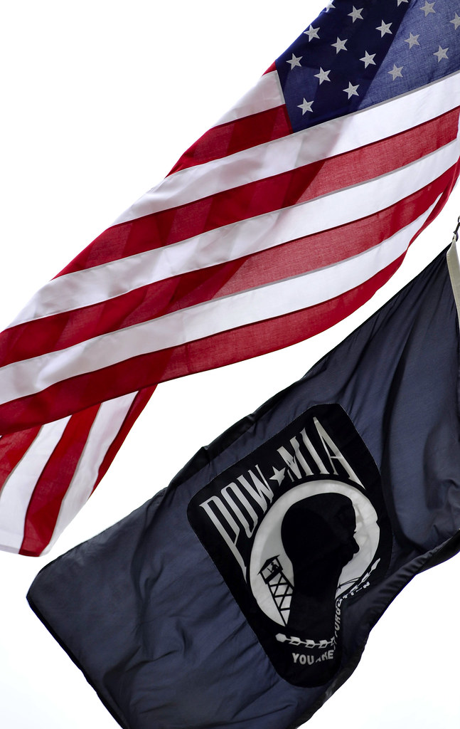
National Defense Programs
Operation Comfort Warrior
National Emergency Fund
Blue Star Banners
Blood Donor Program
Accountability for all POW/MIAs
Notes:
The American Legion is a strong supporter of each of these programs and may be the reasons you joined.
NOTE: Each of these programs are described on the American Legion website: www.legion.org

Slide 8
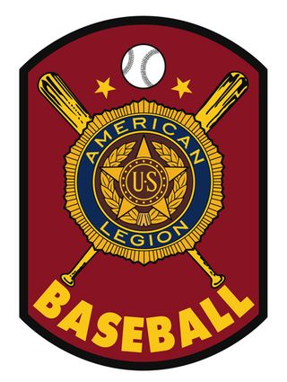
Americanism Programs
Boys State/Boys Nation
Junior Shooting
Oratorical Competition
Youth Law Cadet
Scouting Programs
Education Assistance
Legacy Scholarship
U.S. Flag Protection and Education
ROTC programs
Voter Participation
Notes:
The Big 3 for the Americanism program are Boys State, Oratorical Competition, and Youth Trooper Academy. To see what other programs are part of this take a look at the Americanism Report found on the Department of South Dakota website: https://www.sdlegion.org/ under Forms – Post Adjutant Manual Forms https://www.sdlegion.org/post-adjutant-manual-forms/

Slide 9
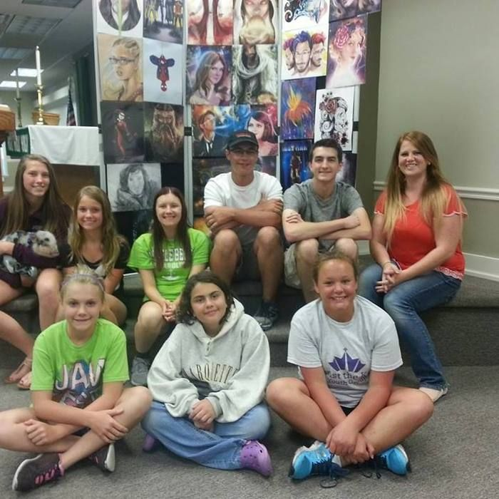
Children and Youth Programs
Family Support Network
Child Welfare Foundation
Notes:
https://www.sdlegion.org/?s=children+and+youth+programs Check out this website for more information.

Slide 10
Take the Online Basic Training Course Enroll on the National Website https://www.legion.org/alei
Notes:
Basic Training course. Have your new and current post members taken The American Legion’s free Basic Training course? The course covers five topics: history and organization; Veterans Affairs & Rehabilitation; National Security; Americanism; and Children & Youth. Each topic offers ways in which American Legion Family members can advance the organization’s values and services in their local communities.
Following a Course Conclusion step in the training program, a 40-question exam is provided. Graduates can download and print a certificate of completion and order a Basic Training Graduate pin from Emblem Sales. Take the Basic Training course online at www.legion.org/training.

Slide 11
Officer and Committee Chair Roles
Commander
Adjutant.
1St Vice Commander
Finance Officer
Chaplin
Sergeant- of-Arms
Historian
Service Officer
Athletic Officer
Notes:
The following are generalizations, each post may have a different set of responsibilities for its officers. If this is true in your post, discuss those instead of the following.
Commander – runs meetings, heads the Executive Committee, Post Liaison with Public (unless post has a Public Relations Officer).
Adjutant – Records post meetings, maintains all post records, handles all paperwork sent to District and State level. All officers send their report to Adjutant. Works closely with membership chair.
Vice Commander – normally works with membership recruitment and acts as commander when commander is not available.
Finance Officer – in smaller posts handles all Bank and money related matters (however all posts should have 2 signature required for disbursement of funds). In larger posts that have an accountant, in charge of overseeing accounts.
Chaplin – in charge of well being of members and family, job may include condolence cards, get well cards, visiting sick members, working with funeral homes to honor our fallen.
Sergeant at Arms – maintains order in meetings, checks membership at meetings, in charge of color guard for flag ceremonies, escorts guests to front of meetings.
Historian – keeps a record of post activities.
Service Officer – works as liaison to County Service Officer, also works with veterans contacting the post for help.
Athletic Officer – in charge of youth sports programs such as Legion Baseball

Slide 12
Committee Member Roles
Americanism Chair
Membership Committee
Finance Committee
Notes:
Here again, describe what you do in your post if different than below.
Americanism Chair – in charge of all youth education programs including Oratorical contest, Boys State program, Youth Trooper, youth baseball, sharpshooter program, Flag Education, any other program assigned by Commander
Membership Committee – works to organize programs to help retain and recruit members
Finance Committee – has responsibility to oversee Post expenditures in larger posts

Slide 13
American Legion Family
American Legion Riders -Chartered
Sons Of The American Legion - Chartered
Auxiliary- Close relatives to a service member - Program of Post
Notes:
American Legion Riders – Motorcycle riders who perform flag lines and escorts, also organize rides among its members
Sons of The American Legion – sons, grandsons, great grandsons, etc are eligible for membership
Founded in 1932, Sons of The American Legion exists to honor the service and sacrifice of Legionnaires
American Legion Auxiliary - close relative to Veteran, mission is to support the Post

Slide 14
American Legion Meetings, Conference, and Convention
Notes:
These are important times when members of the American Legion gather to conduct the business of the organization.

Slide 15
Post meeting
Date and Time
Notes:
Discuss your Post

Slide 16
Mid-Winter Conference
Held Late January or Early February
Provide Annual Training Venue
State Oratorical Contest
Notes:
The MidWinter Conference is generally help in February. It is an opportunity to get to know legionnaries form all over the state. There social activities such as the Go-Getter reception and various speakers. The National Commander often attends this conference. There are also training opportunities for members on various topics of interest to individual legionnaires and posts.

Slide 17
Spring District Meeting
Held Between March 1st and May 1st
Update Members
Merit Awards
Elect Delegates
Election of District officer in even years for even number Districts, in odd years for odd number District. Each year election of county officers.

Slide 18
Department Convention
Held in June
Annual Committee Reports
Election of State Officers
Merit Awards
Hold Committee Meetings on Any resolution brought in by Districts
Notes:
The Department (state) convenes an annual convention each year in June to conduct the business of the Department. There are many activities that are held in conjunction with the Convention. Prior to the start of the convention, there are several committee and commission meetings. The agenda can be found in the Up to Now as the convention time nears each year. On the Friday before the convention, Convention Committees meet to discuss Resolutions that have been submitted for consideration. There is usually a Joint Banquet and Reception with the Auxiliary. The Business of the Convention begins on Saturday and continues through Sunday noonish. There are numerous reports and speakers that update members on what is happening in the American Legion and related entities. Saturday evening there is generally a Foundation Fun Auction.

Slide 19
National Convention
Held in August
Election of National Officers
Vote on Resolutions Brought in by States

Slide 20
Fall District Meeting
Department Commander explains plans and goals for the upcoming year.
District Business

Slide 21
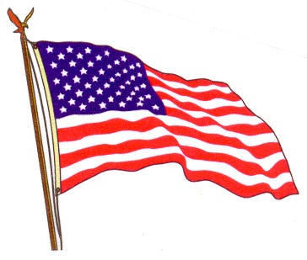
Flag Etiquette at Meetings
Area between flags shall not be crossed.
American Flag will always cross first.
American flag shall not be dipped.
When approaching or departing head table or podium, render a hand salute.
This Photo by Unknown Author is licensed under CC BY-SA

Slide 22
Notes:
You could print this poem as a handout.

Slide 23
Uniform Cap Etiquette

Slide 24
Uniform Cap Etiquette
Left side – Legion Emblem and either city, county, district, or state
Right side
Post Number
Pheasant
Officer title
Cap insignias
Names or nicknames of individual members cannot be used on caps.
Notes:
The left side (emblem side) of the cap is reserved only for the Legion emblem, city, county, district, or state lettering.
If desired, the following items must be placed on the right side of the cap:
Additional lettering, restricted to either the name of a Post or to an officer title, such as Past Commander
Cap insignias or badges for past or present officers
Consecutive membership insignia, membership stars, and/or authorized Legion or military service decorations
Names or nicknames of individual members cannot be used on caps.

Slide 25
Uniform Cap Etiquette Continued
The American Legion uniform cap is worn
When in attendance at official American Legion meetings or ceremonies
At other civil functions when representing the American Legion
A member is considered to be in uniform if wearing an official Legion uniform cap.
The American Legion uniform cap is not worn while eating.
Legion members not in formation will uncover upon entering the place of worship and remain uncovered during the entire service.
When at a funeral, the cap should be held over the heart as one approaches the casket and is not at any time worn in a place of worship.
At the graveside, the cap should be held in the right hand over the heart during the entire service. In cold and inclement weather, the cap should not be worn.
Notes:
The Legion uniform cap should be worn by its members only when in attendance at official Legion meetings or ceremonies or as official guests at patriotic or other civil functions or by individuals when officially representing The American Legion on public occasions.
A member is considered to be in uniform if wearing an official Legion uniform cap. Therefore it is not proper to wear the cap while eating a meal at an official Legion or civic luncheon or dinner.
The cap should be worn in a place of worship only by the Guard of Honor, Color Guard, and Commander of same while in marching order or standing guard. When returned to and seated in pews, the cap should be removed.

Slide 26
Uniform Cap Etiquette for Honor and Color Guards
The cap is worn in a place of worship only by the Guard of Honor and Color Guard while in marching order or standing guard.
When returned to and seated in pews, the cap should be removed.
Legion posts marching in formation into a place of worship should uncover at the door, hold the cap with the right hand over the heart until the arrival in the pews and commanded to take seats, remaining uncovered during the entire service.
At the close of the service, upon command, the post shall arise, the members holding the cap with the right hand over the heart will march out of the place of worship and recover after marching through the door.
Notes:
Legion posts marching in formation into a place of worship should uncover at the door, hold the cap with the right hand over the heart until the arrival in the pews and commanded to take seats, remaining uncovered during the entire service. At the close of the service, upon command, the post shall arise, the members holding the cap with the right hand over the heart will march out of the place of worship and recover after marching through the door.
Legion members not in formation will uncover upon entering the place of worship and remain uncovered during the entire service and will recover after leaving the place of worship.
When at a funeral, the cap should be held over the heart as one approaches the casket and is not at any time worn in a place of worship (except by the Guard of Honor, Color Guard, or Commander of same while in marching order or standing guard.) At the graveside, the cap should be held in the right hand over the heart during the entire service. In cold and inclement weather, the cap should not be worn.

Slide 27
Uniform Cap Etiquette Continued
In Legion meetings, the cap should be worn except during moments of the Pledge of Allegiance, prayer, and when standing in silent reverence in memory of departed comrades, when the cap should be held with the right hand over the heart.
Female members of the Legion should wear their caps in the manner prescribed for female personnel of the armed services.
Source: Officer’s Guide

Slide 28
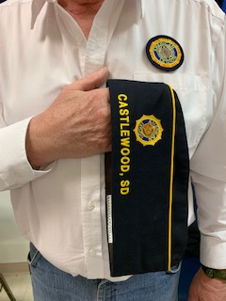
American Legion Cap during Pledge of Allegiance and Prayers

Slide 29
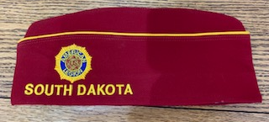
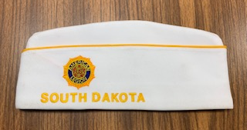
Red and White Caps
National Cap
Department Cap

Slide 30
Blue with White Caps
District Cap
County Cap

Slide 31
Blue Caps
City/Post Cap
State or Post 500

Slide 32
What do legionnaires wear on their caps?
Left Side
Right Side
Notes:
Nothing should be displayed on the left side of the cap. In South Dakota we wear a pheasant above the Post number on the right side. Additionally on the right side the member may wear earned pins and awards and ribbons. No nicknames or obscene items are to be worn on the cap.

Slide 33
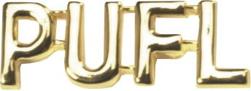
Cap Pins
Paid Up For Life
Continuous Years Pin
Continuous years Star
Go Getter Star (Silver color with year)
Notes:
Here are some examples of items that can be worn. Often you will see current office held or such items as Past Commander pins.

Slide 34
We Continue to Serve Volunteering
If you want to help say so, you will not be turned down.
Inform the Adj. or the person in charge of the committee you wish to help. IE. Chaplin's are always looking for more members on a call list for wakes and funerals. Membership chair will need helpers for Buddy check call in Jan.
If you can’t help do to a full work load, we understand. (Help when you can).
Remember no idea is too small or out of line. It may have never been asked and you are the brave one to bring it up.
Just because “We have always done it this way”, does not mean we can’t look at a program or problem a different way.
We are all Brothers and Sisters in arms, please treat everyone with the respect you would like given to you.

Slide 35
Thank You for Your Service Thank You for joining Our Post

Slide 36
Thank You Questions?

