Slide 1
How to Run an Effective Meeting
Lena Heredia-Perez
Department of Florida
5th District Commander
Notes:
Who runs the Post?
The only way Post members can participate in running the Post is by participating in the Post Membership Meetings. That is the only way they can have a voice in what the post is doing and what programs the Post does. Meetings are a mechanism by which Post members can be informed and are able to participate in decision making. The Post Commander does not run the Post or is a Dictator.

Slide 2
Overview
Purpose
Resources
Preparation
Conduct During the Meeting
Conducting the Meeting

Slide 3
Essential Tools
Officers Guide & Manual of Ceremonies
District / County Commanders Guide
Constitution and Bylaws
Roberts Rules of Order (Current Edition)
List of Officer’s and Committee Chairs
Minutes of Previous Meetings
Agenda
Script
Notes:
2022 Officers Guide & Manual of Ceremonies can be found on legion.org under the Internal Affairs Tab Page 41-45

Slide 4
Preparing for a Meeting
Gather Agenda Items
Publish Agenda
Send out Reminder
Set Up the Space
Notes:
Let’s face it, The American Legion is a volunteer ran organization and many of us are involved in other organizations. A friendly reminder goes a long way.
Preparation and execution of an agenda are equally important to a meetings success.
In the 5th District we always try to get the agenda out to the members a week out from our scheduled meeting.
Make sure that your Chairman get the agenda for the upcoming meeting and are aware of what you would like them to report on. A phone call prior to the meeting is always nice as well, to ensure they got your message.

Slide 5
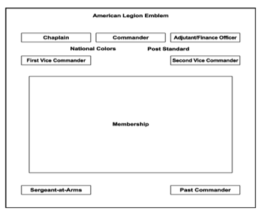
Set Up Meeting Room
Notes:
Plan of a Post Meeting Room / Plan of Post Meeting Room for Special Ceremonies can be found on Page 36 – 37 of 2022 Officers Guide & Manual of Ceremonies on Legion.org / Internal Affairs Tab
Set up is generally done by the Sgt-At-Arms & must be setup prior to the meeting.
This arrangement is practical for regular post meetings. Always include the ‘empty chair for POW/MIA portion of your meeting.
The room should be comfortable for all attendees with enough seating a available.
Sergeant-at-Arms should ensure there is a table at the entrance to the meeting room with a sign-in log.
Every District should adjust their setup to meet their particular needs and/or physical limitations.
Ensure that you have a sign in sheet

Slide 6
Parliamentary Procedures
Keep an Orderly process
Expedite business
Keep the organization focused on its goals and principles
Understand the basics – get the Robert’s Rules of Order Book or Pamphlet
Notes:
Officers Guide & Manual of Ceremonies Page 99-105
PARLIAMENTARY PROCEDURE is the application of parliamentary law to the conduct of an organization. It is wise for all leaders to familiarize themselves with the technique of conducting a meeting. While it is important that the members understand the fundamental
rules of parliamentary procedure, this knowledge should be used only to ensure order, to expedite business, and to develop an organization that will cleave to the objects for which it was organized.

Slide 7
Conduct During the Meeting
Uniform of the Day
Late Arrival to Meeting
Cell Phone Etiquette
How to ask Questions or Make Comments
Notes:
UNIFORM OF THE DAY
A Legionnaire is considered in uniform when wearing the official American Legion Cap. That is your blue ”cover, or garrison cap”.
Leadership should wear an appropriate color name tag with their name, title, and post during the meeting and official Legion events.
ENTRY IF YOU ARE LATE
You should not enter, and the Sgt at Arms should not allow entry, during the initiation of or close of any meeting. If you are late and enter once the meeting has begun, you should enter the room, salute the colors and quietly take your seat.
CELL PHONE ETIQUETTE
Remind the membership to turn off or silence their phones during the meetings and please remember to do the same to your phone.
QUESTIONS AND COMMENTS
Members with questions comments and concerns should rise, be recognized by the chair and always address chair with those questions, comments and concerns
Always be courteous to the chair and your comrades

Slide 8
The Commander’s Role
Take charge and stay in charge
Ensure everyone is allowed to speak
Keep the discussions on track
Save new or unrelated issues for the final part of the meeting – For the Good of the Legion
Notes:
The goal is to conduct the required business in the most effective time frame; NOT “get done as fast as possible”

Slide 9
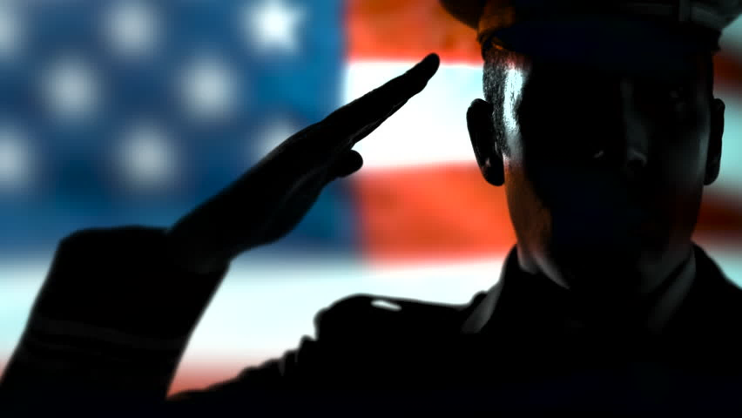
Opening
Ceremonies

Slide 10
Opening Ceremonies
Salute the colors
Prayer
POW/MIA remembrance
Pledge of Allegiance
Recite the Preamble to The American Legion Constitution
Notes:
Remind all in attendance to silence or turn off their phones.
The Opening Ceremonies should always be done in this order (Possible deviations for education or training)
No One should enter the meeting until after the Opening Ceremonies have concluded.

Slide 11
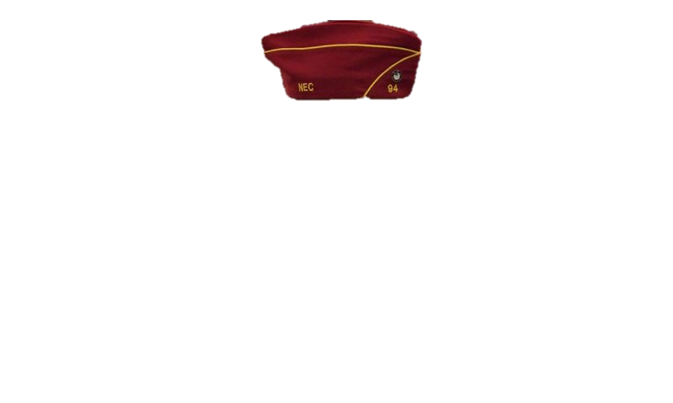
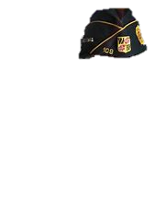
Order of Business
Call to Order (Opening, Roll Call, Minutes, Correspondence)
Introduction of Guests/Officers
Finance Report
Chairman / Committee Reports
Notes:
Please note that NOT ALL Posts/Districts/Counties have share the same order of business; however they should have a prescribed order.
Roll Call is sometimes called for prior to the reading of minutes or the introduction of guests, but often it is found better to do this just before commencement of the business of the meeting.
In district meetings, it is always well to introduce past district commanders and never overlook past department commanders or National Executive Committeemen. When making introductions, do not ask those introduced for remarks at that time. Later, it may be in order to hear from certain distinguished guests
If department officers are present, they should be given special recognition and the opportunity to extend greetings. This should be done by the district commander, who will invite such officers to take their place for their remarks.
If the department commander is present, he/ she should be introduced with respect and dignity and given the floor for such period as may be desired.
Auditing procedures can be found in the Constitution & By-Laws
Chairperson Reports - Persons making reports should be called upon by their name, post number and title of the office for which they are reporting and then requested to come to the front and address the meeting. If the district commander knows an official or committee chair has no report, then it is better to not call upon that person.

Slide 12
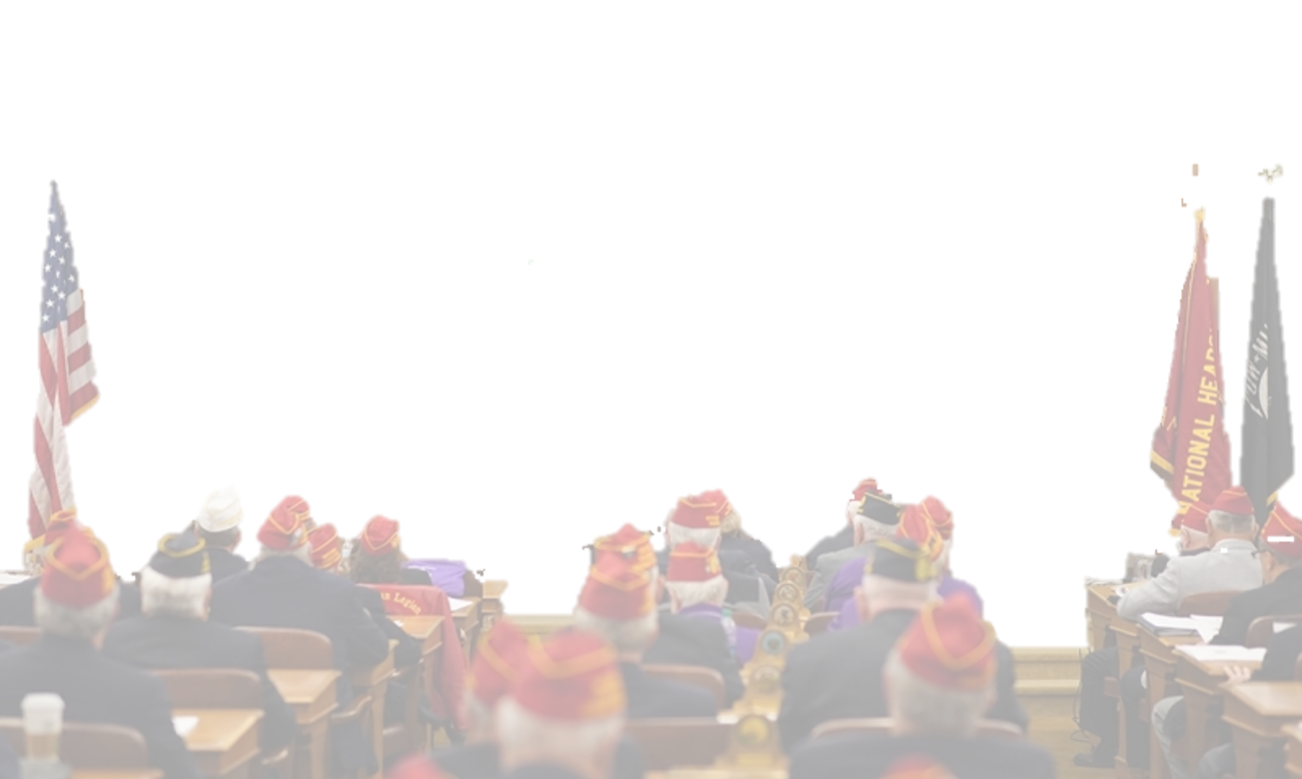
Order of Business (2)
Unfinished Business
New Business
Program – Training / Presentation, etc…
For Good of the Legion
Adjournment
Notes:
If chairpersons / post commanders are to report to the meeting it is important they are informed in advance of expectations to report and an outline provided on what the report is expected to cover.
Post Commanders / District Commander Report: Commanders should by all means have a personal report to make, and time should be spent in its preparation so the program may be properly presented. It would be well to give special recognition to posts or officers doing an outstanding job, as an encouragement to them and a stimulation to others
Announcements: No meeting should ever be concluded without announcement of coming events, such as department conferences, special programs or forthcoming observances. At all such meetings, reminders of membership deadlines and active programs should be announced.

Slide 13
Closing the Meeting
Prayer
Recovery of the POW/MIA Flag
Salute / Retire the Colors
Closing Remarks
Notes:
District Commanders should never close the meeting without an expression of appreciation to those who have attended, for their interest and support of the conference, and to the host post for its hospitality

