Slide 1



Welcoming New Members: Turning a Joiner Into a Legionnaire
Fred Nelson/Jack French - Midwinter 2026
Notes:
Mentoring plays a crucial role in the success of the American Legion for several reasons:
Knowledge Transfer: Mentoring allows experienced members to pass on valuable knowledge and skills to newer members. This transfer includes insights into the organization's operations, traditions, and values, ensuring that these continue to be upheld.
Member Engagement: Through mentoring, new members receive guidance and support, helping them feel more connected and engaged with the organization. This engagement is vital for member retention and active participation in programs and activities.
Leadership Development: Mentoring helps in identifying and developing future leaders within the American Legion. By nurturing leadership skills among new members, the organization ensures a steady stream of competent individuals ready to take on leadership roles.
Community Building: Mentoring fosters a sense of community and camaraderie among members, which is fundamental to the American Legion's collaborative spirit. Strong interpersonal relationships help build a supportive and cohesive membership base.
Problem Solving and Innovation: Experienced members can guide new members through challenges and encourage innovative thinking within the organization. This problem-solving approach is essential for adapting to changing circumstances and needs.
Cultural Continuity: Mentors help inculcate the organization’s ethos and cultural norms to new members, ensuring that the foundational principles and the spirit of the American Legion are preserved.
In summary, mentoring is vital for nurturing competent, engaged, and well-informed members who can contribute significantly to the ongoing success and resilience of the American Legion.

Slide 2
Session Purpose
Help Posts improve how new members are welcomed.
Focus on connection, engagement, and retention.
Provide simple, repeatable tools for Post leaders.
Notes:
Becoming a mentor in the American Legion offers several rewarding benefits, both for the mentor and the broader organization:
Personal Satisfaction: Mentoring provides a deep sense of fulfillment as you help others grow and succeed. Seeing a mentee develop and contribute meaningfully to the American Legion can be incredibly rewarding.
Leadership Skills: Mentoring helps in honing your leadership skills. By guiding others, you practice communication, patience, empathy, and problem-solving, which are crucial leadership qualities.
Giving Back: Many members see mentoring as a way to give back to the organization that has supported them. It's a chance to ensure the American Legion remains strong and vibrant for future generations.
Strengthening the Organization: By mentoring, you contribute to building a more knowledgeable and capable membership base. This strength ensures the American Legion can effectively pursue its mission and serve its community.
Professional Growth: Mentoring others can also enhance your own skills and knowledge. Teaching is an excellent way to reinforce your own understanding and often provides new perspectives and ideas.
Networking: Engaging with mentees and other mentors can expand your professional and personal network within the American Legion. These connections can be invaluable for both personal growth and organizational involvement.
Cultural Continuity: Mentors play a crucial role in transmitting the values, traditions, and practices of the American Legion. This continuity is key to maintaining the organization's identity and purpose.
Personal Legacy: Being a mentor allows you to leave a lasting impact on the organization and its members. Your influence helps shape the future leaders of the American Legion, contributing to your personal legacy within the community.
In sum, being a mentor is a powerful way to influence the American Legion positively, offering both personal and professional rewards while ensuring the organization's enduring success and relevance.

Slide 3
Why Welcoming Matters
Recruitment brings members in.
Retention depends on belonging.
Many members leave because no one engaged them.

Slide 4
The New Member Perspective
They want to belong and contribute.
They may not understand how the Post works.
Silence often feels like rejection.

Slide 5
Common Pitfalls
Handing over a card with no follow-up
No introduction at meetings
No clear path to get involved

Slide 6
The 4-Step Welcome Model
1. Acknowledge
Acknowledge
Acknowledge
2. OrientOrient
4. Follow up
3. Connect
Notes:
The concept of "decision balance" refers to a method used in decision-making that involves weighing the pros and cons of a particular choice.
Components of Decision Balance
Pros of Changing (Benefits): These are the positive outcomes or advantages that can result from making a change. Identifying these benefits helps motivate the individual towards taking new actions or adopting new behaviors.
Cons of Changing (Costs): These are the potential drawbacks or sacrifices involved in making a change. These might include time, effort, discomfort, or other negative outcomes associated with adopting the new behavior.
Pros of Not Changing (Advantages of Status Quo): These are the benefits or comforts associated with maintaining current behaviors or circumstances. This might include ease, enjoyment, familiarity, or any positive aspect of not making a change.
Cons of Not Changing (Disadvantages of Status Quo): These are the disadvantages or negative consequences of not making a change. This could involve health risks, missed opportunities, long-term disadvantages, or any other negative outcome of staying the same.
Benefits of Using Decision Balance
Enhances Self-awareness: It forces individuals to critically evaluate their own values and the impact of their choices, leading to greater self-awareness.
Reduces Ambivalence: By clearly laying out all aspects of a decision, it can help reduce ambivalence, making it easier to make a confident choice.
Facilitates Change: It can be a powerful tool in facilitating actual behavior change by allowing a clear comparison of the status quo versus the proposed change.
Decision balance is a practical approach to making thoughtful, well-informed decisions by considering the full spectrum of outcomes associated with various choices.

Slide 7
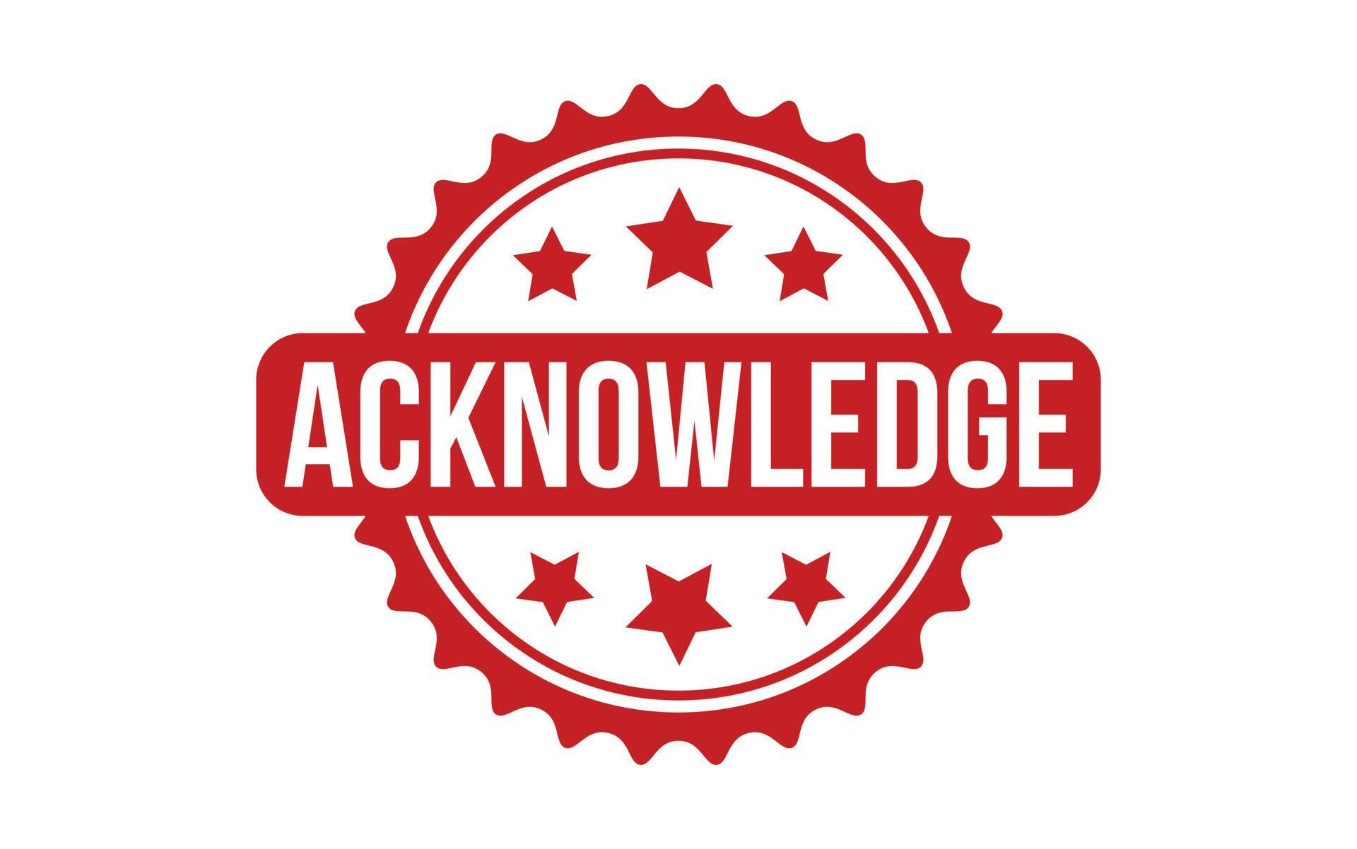
Step 1: Acknowledge
Thank them personally
Introduce them at a meeting or event
Make them feel seen and valued

Slide 8
Step 2: Orient
Explain what the American Legion does
Review Post officers and meetings
Share major programs and activities

Slide 9
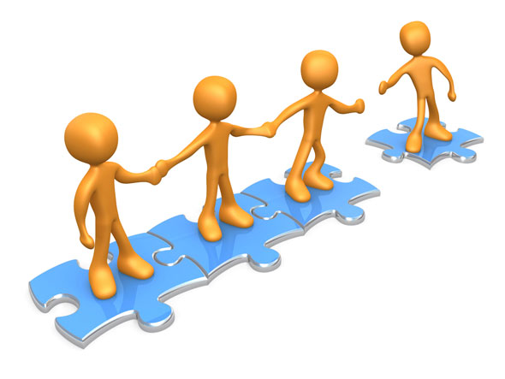
Step 3: Connect
Assign a mentor or point of contact
Invite them to a specific activity
Help them find their place

Slide 10

Step 4: Follow Up
Contact within 30 to 60 days
Ask how things are going
Encourage continued involvement

Slide 11
Post-Level Tools That Work
New member orientation nights
Welcome packets
Committee sign-up sheets
Post tours and social time
Your guide to welcoming new members | The American Legion

Slide 12
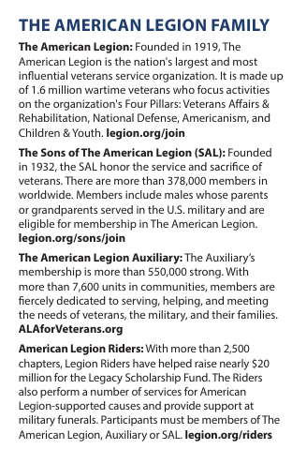
The American Legion Family
American Legion Auxiliary
Sons of The American Legion
American Legion Riders
Family involvement increases retention

Slide 13
Reflection for Your Post
What do we currently do well?
What can we improve?
What is one change we can make in 60 days?

Slide 14
Closing Message
1. Recruitment brings them in
2. Welcome makes them stay
3. Make welcoming intentional

Slide 15
Purpose Fulfilled – Mission Accomplished!
We discussed the benefits of welcoming new members.
We focused on the four-step model strengthening connection, engagement, and retention.
We talked about expectations and/or possible changes for your own Post.

Slide 16
Questions?
Notes:
Five Tips for Mentoring Success
Spot potential in others.
Act as a networking and resource guide.
Display patience and tolerance. Not everyone thinks the same way.
Encourage.
See the big picture!

