Slide 1



Reports & Awards

Slide 2
REFERENCES AND RESOURCES
Dept of South Dakota Post Adjutant’s Administrative & Awards Manual (new every year)
American Legion Post Adjutant’s Manual (new every year)
South Dakota American Legion website: sdlegion.org
National American Legion website: legion.org
Department Up To Now (good updates and deadline reminders)

Slide 3
WHAT WE WILL COVER IN THIS CLASS
What reports are required from a post
When are they due
What instructions and where can they be found
What awards are available
When are they due
What instructions and where can they be found

Slide 4
Reports – Post Data Report
National Form to update Post information
Mailed out in February time frame, Dept has copies
Due to Department Headquarters by April 15th
National must have form by May 1st to make any updates
EXTREMELY important for upcoming dues increase
Instructions are included

Slide 5
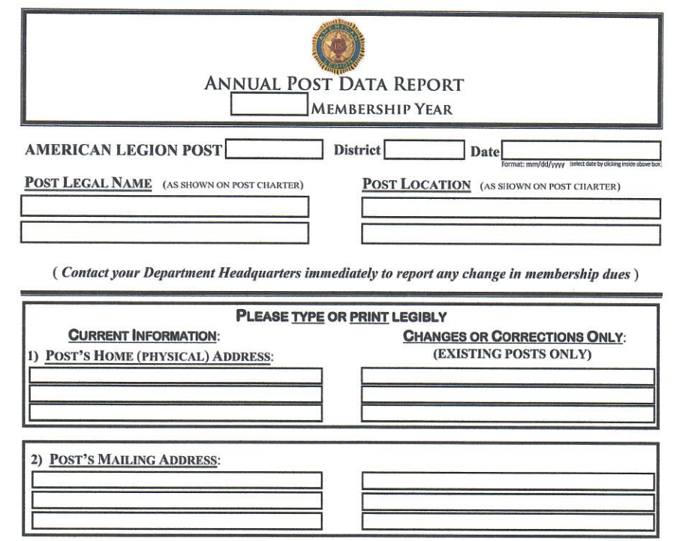

Slide 6
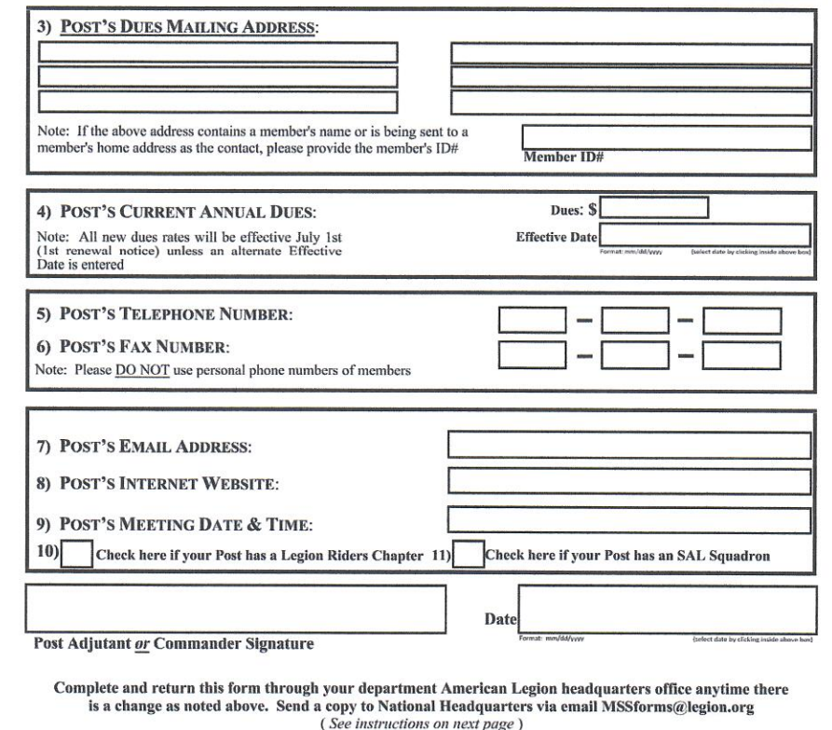

Slide 7
Reports – Officer Certification Form
Department form to report results of Post elections
Form is due to Department Headquarters after completion of elections, completed by outgoing Adjutant and try to get to HQ by May 1st
Form available in Adjutants manual and on Department website
Important to fill out each officer with complete address, phone and email

Slide 8
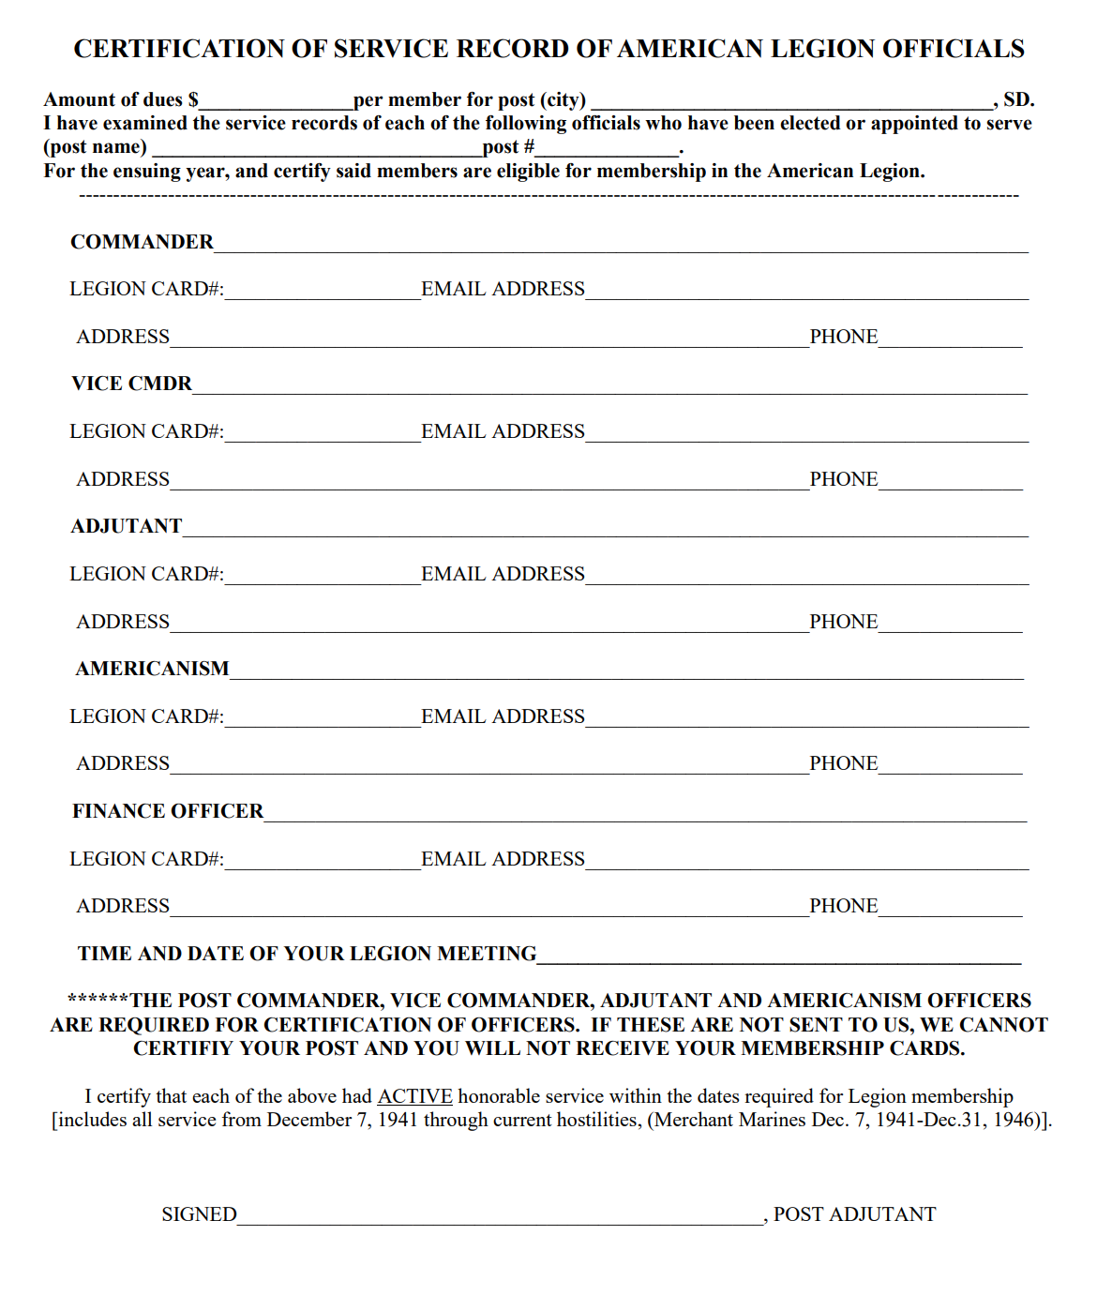

Slide 9
Reports – Consolidated Post Report (CPR)
National Form to account for Post contributions
Mailed out with Up To Now in the spring
Due to Department Headquarters by June 1st
Can do it electronically at Mylegion.org
National compiles all department’s inputs for the National Commanders report to congress.

Slide 10
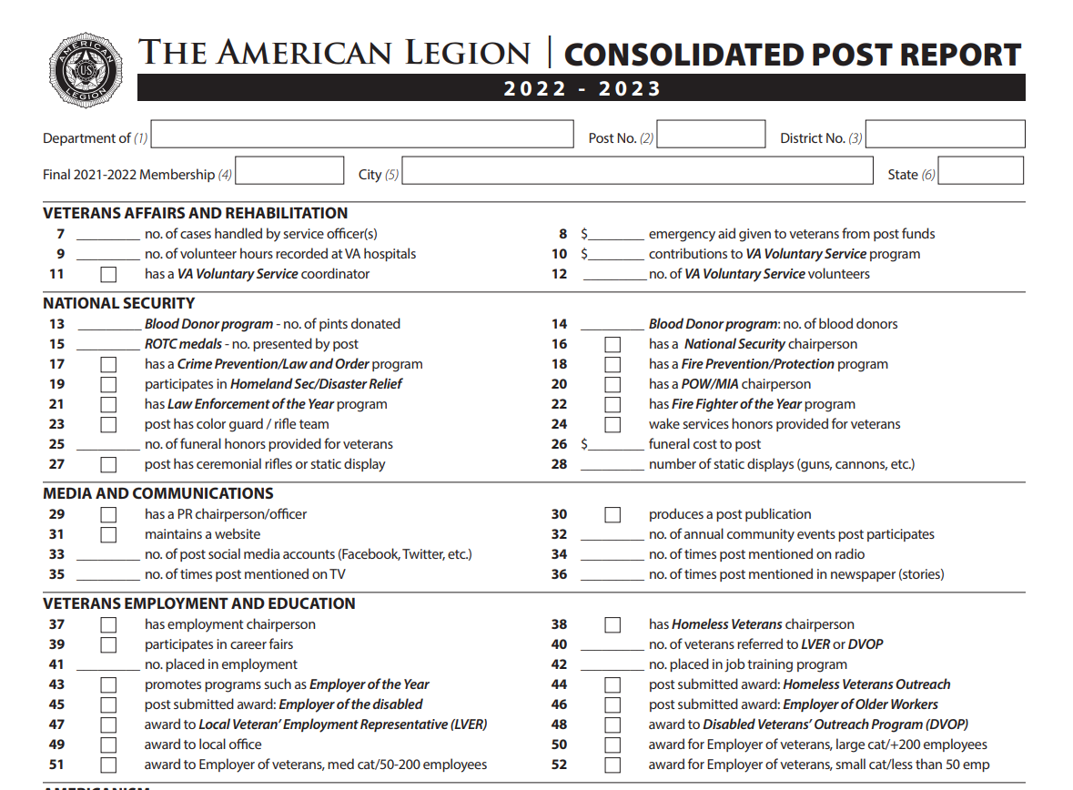

Slide 11
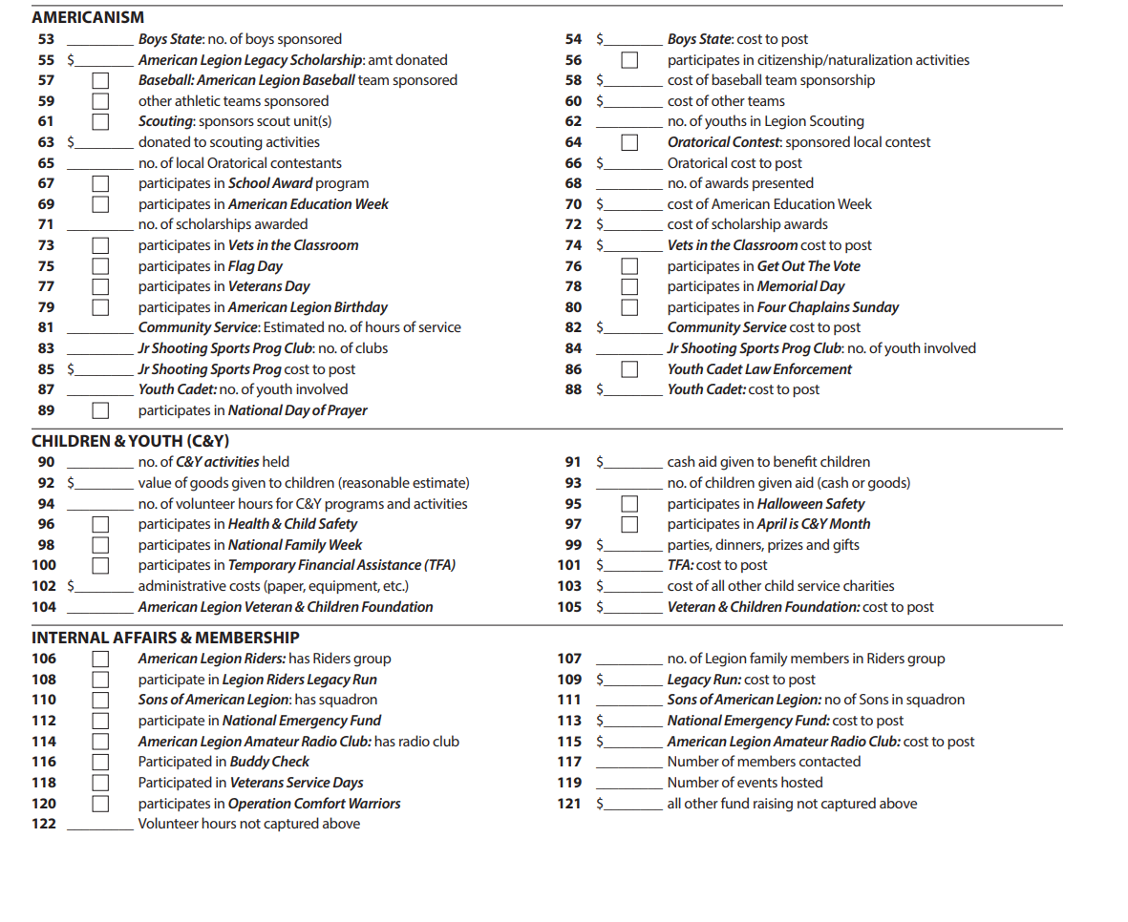

Slide 12
Reports – Americanism Report
Report and instructions can be found in Dept Adjutant’s manual and on Dept website. Report usually due May 1st.
Department Americanism Awards are based on this report and additional documentation

Slide 13
Reports – Go Getter Certification
To be submitted prior to Midwinter Conference and Department Convention to identify those Go Getters authorized to participate in the Go Getters event
Report and instructions found in the Department Adjutant’s Manual and Dept website

Slide 14
Reports – Form 990
IRS regulations require all non-profits, 501(c)19, to file tax returns on the Form 990
Must be filed by the 15th day of the 5th month of the accounting period (Nov 15th)
Failure to file the Form 990 can result in the organizations tax exempt status to be revoked.
For most, this can be done quickly and on line.

Slide 15
Reports – Annual report to SD Sec of State
Non-Profits must file an annual report with SD Secretary of State to maintain good standing
Report contains basic organization data
Report must be filed on the fist day of the month the business was started
More information can be found at https://sdsos.gov/Business-Services/default.aspx

Slide 16
Reports – Post Constitution and Bylaws
Every post must have up to date Constitution and Bylaws
These govern how the post is to operate and should be post specific and can become legal issue if not followed
These should be reviewed annually and updated as needed. A copy should be sent to Dept HQ annually
Sample C&BL are available on the Dept website

Slide 17
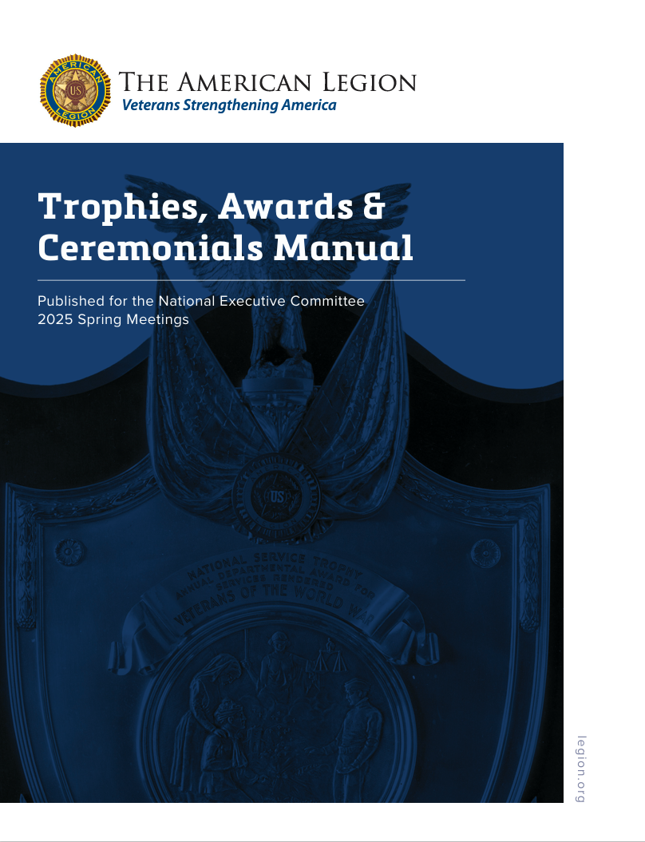

Slide 18
Awards – Employer Awards
National awards given at Department level
Various awards for employers which employ veterans
Awards based on size of company and type of employment such as number of veterans as well as older and disabled veterans
Requirements and application can be found on the Department website under forms and are due to Department Headquarters by November 15th.

Slide 19
Awards – National Firefighter/EMT of the Year
National and Department level award
Posts submit nominations direct to Department Headquarters by December 31st. Covers time frame of 1 July to 30 June of year of selection. Applications must be complete or will be not reviewed.
Requirements and application can be found on the Department website under forms

Slide 20
Awards – National Law Enforcement Officer of the Year
National and Department Level Award
Posts submit nominations direct to Department Headquarters by December 31st. Covers time frame of 1 July to 30 June of year of selection. Applications must be complete or will not be reviewed.
Requirements and application can be found on the Department website under forms

Slide 21
Awards – Eagle Scout of the Year & Scouting
National and Department level award
Eagle Scout Award and scholarships are available
Posts submit nominations direct to Department Headquarters by March 1st.
Requirements and application can be found on the Department website under programs.
Adult Scouter knot information is on National website

Slide 22
Awards – SD Educator of the Year
Department Level Award
Posts submit nominations to the District Commander 10 days prior to Spring District Meetings, who selects and forwards to Dept Headquarters by May 1st.
Requirements are found at the Department website under forms

Slide 23
Awards – SD Good Samaritan Award
Department Level Award
Posts submit nominations to the District Commander 10 days prior to District Spring meetings, who selects and forwards to Dept Headquarters by May 1st.
Requirements are found at the Department website under forms

Slide 24
Awards – Americanism Report/Competition
Department level awards based on submitted Americanism reports and based on Post size
All posts that submit report receive Americanism citation
Golden Eagle Award to Post that submits best report in each size category
Distinguished Service Citation to Post with most outstanding program
Meritorious to second place post
Americanism Officer of the year to the Americanism Officer of Distinguished Post
Reports must be received by May 1st at Department Headquarters

Slide 25
Awards – William Lenker VA&R for Excellence
Department level award
Based on VA&R pillar of The American Legion
Inputs due to Dept Headquarters May 1st
Requirements and application can be found on the Department website under forms.
Notes:
The William F. Lenker National Service Trophy is to be awarded annually to the Department of The American Legion excelling in welfare and rehabilitation work for war veterans and their dependents; providing, that the membership of that Department shall be no less than 80 percent of the preceding year. For this purpose, membership of the Department used in this calculation is to be based on the record as shown in the books of the National Treasurer on the last day of the preceding fiscal year.

Slide 26
Awards – South Dakota American Legion Press Association (SDALPA) contest
Department level award
Goal is to recognize Posts with outstanding newsletters or newspapers
Submissions are due 2 weeks prior to Dept Convention or prior to the SDALPA luncheon at convention.
Additional information can be found on Dept website under publications

Slide 27
Awards – Post History Awards
Department level award
Goal is to document the Post’s history each year.
Either a narrative or scrapbook style can be used
Due to HQ or to the registration table by 1 pm on Friday of Convention
Additional information can be found on Dept website under forms

Slide 28
Awards – Outstanding Post Adjutant
Recognizes the work and dedication of Post Adjutants
District Commanders select one from their District and forward to Dept Headquarters by June 1st
Posts forward forms to the District Commanders for consideration and selection and forwarding to Dept HQ
Additional information and forms can be found on Dept website under forms

Slide 29
Awards – Outstanding Post Commander
Recognizes the work and dedication of Post Commanders
District Commanders select one from their District and forward to Dept Headquarters by June 1st
Posts forward forms to their District Commander for consideration and selection and forwarding to Dept HQ
Additional information and forms can be found on Dept website under forms

Slide 30
Awards – Children and Youth
Following Awards are recognized by National Headquarters:
100% Post C&Y reporting (District award)
Outstanding Achievement (individual)
Outstanding C&Y Program (Post)
Dedicated service to C&Y (Post)
Requirements and application found in National C&Y Program guide on National Website (legion.org)

Slide 31
Awards – Membership for Individuals
Individual award based on recruiting new members. Application must be at Dept Headquarters by May 15th
Gold Brigade – recruits 50 or more new members
Silver Brigade – recruits 25 – 49 new members
Bronze Brigade – recruits 15 – 24 new members
See Dept or National websites for additional information

Slide 32
Awards – Membership for Posts
There are many awards for Posts that meet National membership target dates.
To be eligible Posts must have certified their officers
See the Dept Posts Adjutant’s Administrative and Awards Manual for specifics or the Dept website

Slide 33
Other items to be aware of
Ceremonial rifles and ammunition information can be found in the National Adjutant manual and Dept website under forms.
Request for ammunition must be forwarded through Dept Headquarters on proper form.
Ceremonial rifles are the property of the US Army and loaned to post. They must be periodically inventoried and returned if no longer needed.

Slide 34
Reports and Awards, “Where to find them on the web”
Department website: sdlegion.org https://www.sdlegion.org/
National website: legion.org https://www.legion.org/
National Post Adjutant’Manual https://www.legion.org/sites/legion.org/files/legion/publications/89IA1123%20Post%20Adjutants%20Manual.pdf

Slide 35
Questions?

